Slide 1

Exploring Hotels in Gurgaon
Maram Bharath simha reddy

Slide 2
Introduction
Whenever a person plan to visit a new city, their most important task is to book a nice hotel to enjoy their stay. The person might want to know how good a given hotel is or the price range it falls under. This extra information would help decide which hotel to choose amongst the many available in the city. Combining the location of the hotels in the city with their rating information would surely help visitors in a city make their stay comfortable.
This project explores various hotels in Gurgaon and attributes the data based on user ratings. To explore this information, I have used Foursquare API and the Goibibo API to fetch complete information of various hotels (including name, address, pincode, category and rating). Further, a map of the hotels with specific color attributes will be plotted to highlight their position, and information about these hotels.

Slide 3
Data acquisition and cleaning
Use Foursquare’s explore API and fetch venues up to a range of 10 kilometers from the center of Gurgaon and collected their names, categories and locations (latitude and longitude)
Filter the data based on categories and extracted only hotel records.
Fetch hotel data from Goibibo(Travel site). Use Goibibo search API to fetch hotel details from its database giving city id as parameter.
https://developer.foursquare.com/docs/api/venues/explore
https://developer.goibibo.com/docs
Final dataset has 198 rows with 5 columns (name, pincode, rating, latitude, longitude)

Slide 4
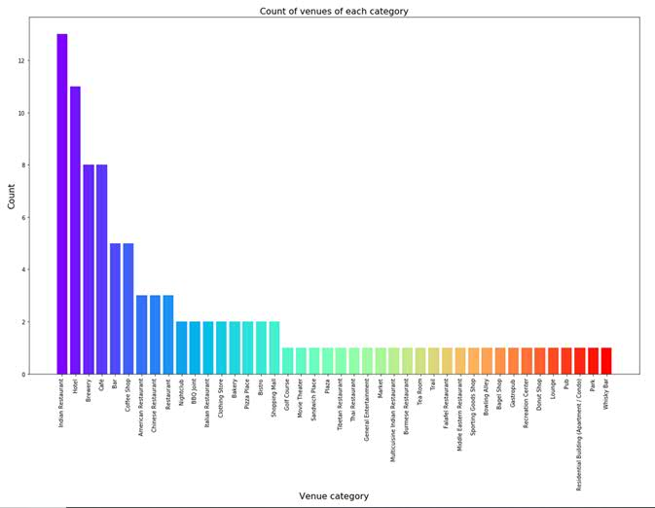
Data Analysis - Categories
Begin analysis by looking at the various categories of venues that exist in Gurgaon
From figure, we can see that the majority venues are Indian Restaurants. This is closely followed by Hotel. Gurgaon is clearly hub for great food and comfortable stay

Slide 5
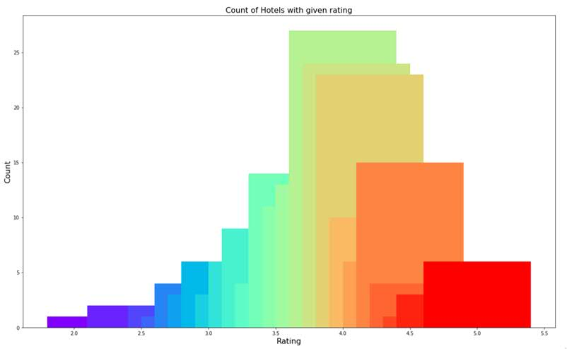
Data Analysis - Rating
Explore the ratings of various hotels in Gurgaon.
Plot a bar chart with x-axis as the rating from 1 to 5 and the y-axis as the count of hotels with that rating.
Plot the bar chart to see what average rating hotels get in Gurgaon.
Whole range of rating of hotels might stretch from 1 to 5, the average rating is spread across 4 with maximum number of hotels scoring between 3 and 5

Slide 6

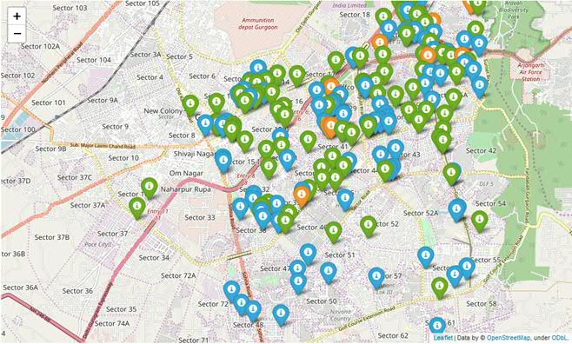
Bin | Label | Color
1-2 | Low | Red
2-3 | Okay | Orange
3-4 | Good | Green
4-5 | Very Good | Blue
Plot the venues on the map of Gurgaon. You can see color mapping with Label in table. Looking at figure reveals the same results as the bar plot. However, it is interesting to note that many high rated hotels are located near Sector 29, Iffco Chowk and Golf Course Road. Few are present near Sector 48 and Sector 50.

Slide 7
Conclusion
After collecting data from the Foursquare APIs, we got a list of 100 different venues and we extracted data for Hotel. We got 11 hotels from Foursquare API. Then we used Goibibo API to extract rating for those11 hotel. However, rating was available only for 7 hotels, so we extracted more data from Goibibo database based on location. Final dataset results in total 198 hotels.
We identified that from the total set of venues, majority of them were Indian Restaurants and Hotels. Then we further continued analysis based on Hotel.
While the ratings range from 1 to 5, majority hotels have ratings close to 4. This means that most hotel provide nice and comfortable stay to the visitors, thus indicating the high rating. When we plot these hotels on the map, we discover that there are clusters of hotels around Sector29, Iffco Chowk and Golf Course Road. These clusters also have very high ratings (more than 3).
A company can use this information to build an online website/mobile application, to provide users with up to date information about various hotels in the city based on the search criteria (name, location, rating).

